Slide 1



UNIVERSITY CHATBOT
A New Generative Approach to
Optimize the Network and
Server Load of Websites

Slide 2

INTRODUCTION
The university chatbot is an innovative platform designed to consolidate and simplify access to the wealth of information spread across the university websites. By utilizing advanced technologies like RAG, FAISS, and generative AI, the chatbot empowers users to quickly and accurately retrieve the information they need.
Key Features:
University-Specific Data Repository
Advanced Query Processing
Dynamic Response Generation
Enhanced User Experience

Slide 3
TABLE OF CONTENTS
01
02
03
04
05
06
Application Usage
Core Technologies and Frameworks
Query Processing and Classification
Backend Architecture and Integration
Data Flow
and Model Optimization
Conclusion

Slide 4
01
APPLICATION USAGE

Slide 5
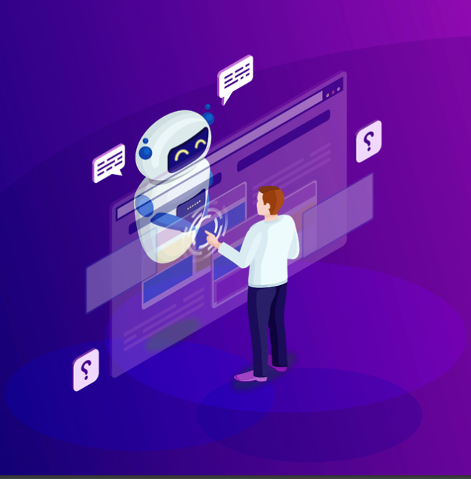
Chatbot Integration for GSU Webpage
Our Flask-based chatbot seamlessly integrates with the GSU webpage, serving as a domain-specific assistant for students, faculty, and staff. Leveraging advanced technologies like CRAG (Contextual Retrieval-Augmented Generation), FAISS (Facebook AI Similarity Search), and Google Gemini, it delivers accurate, context-aware responses to user queries.
Key Features:
Simplified Access: Provides critical university information without navigating multiple pages.
Advanced Retrieval: Captures relevant articles and offers precise responses.
Scalability: Future database expansions and additional data integrations will enhance capabilities.
This chatbot not only streamlines communication but also reduces the workload on university web servers, showcasing the potential of AI-driven solutions in academia.

Slide 6
02
CORE TECHNOLOGIES & FRAMEWORKS

Slide 7
Technologies & Frameworks used
FLASK
RAG
Flask is a lightweight web framework powering the chatbot backend. It connects AI technologies (RAG, CRAG, FAISS) with the user interface, enabling real-time query processing and response delivery.
Retrieval-Augmented Generation (RAG) combines retrieval-based systems with generative AI to deliver accurate, context-aware responses. It enhances NLP by integrating both retrieval and generation for more flexible query resolution.
CRAG
FAISS
CRAG is an advanced version of RAG that improves contextual understanding in retrieval and response generation. It uses corrective embeddings and multi-stage filtering to ensure retrieved information perfectly matches the user's query.
FAISS is a high-speed vector search engine designed for efficient document retrieval. It plays a pivotal role in identifying the most relevant knowledge chunks based on user queries.

Slide 8
Retrieval-Augmented Generation
Key Components of RAG:
Retrieval Mechanism: The first stage in RAG involves a retrieval mechanism that employs transformer-based models like BERT to search through extensive knowledge bases. These sources, which may include structured databases or unstructured text corpora, are scanned to identify the most relevant passages, sentences, or data matching the user’s query.
Generative Model: After retrieving the relevant content, the generative model—typically based on architectures like GPT—processes the information to craft natural language responses. These responses are designed to be coherent, contextually precise, and conversationally engaging.
Fusion of Retrieval and Generation: RAG integrates retrieval and generation through an encoder-decoder framework. This fusion enables the generative model to ground its outputs in real-world data from the retrieval stage while maintaining fluency and natural language quality.
End-to-End Training: The retrieval and generative components of RAG are trained together in an end-to-end manner. This approach enhances both retrieval accuracy and the overall quality of responses, ensuring the system adapts effectively to domain-specific needs.

Slide 9
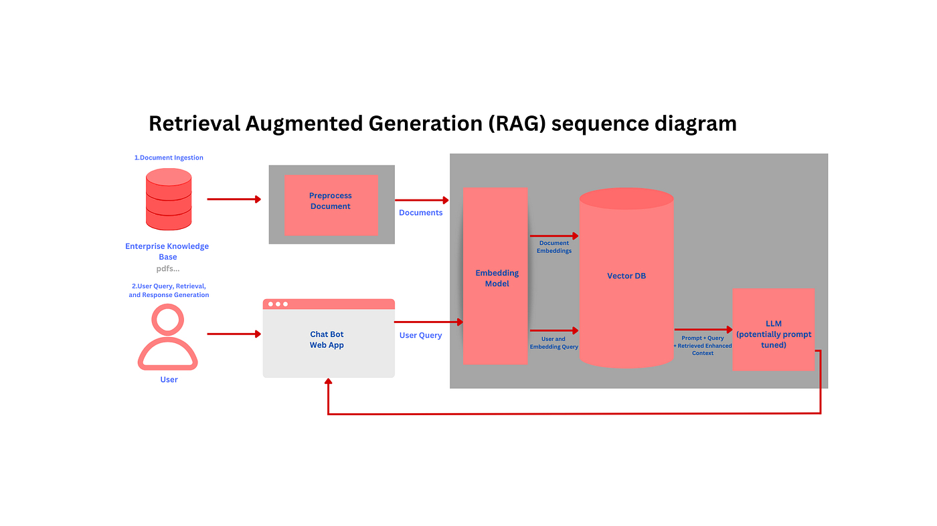
Benefits of RAG in the Chatbot
Reduced User Clicks: Provides direct, relevant answers, minimizing navigation and enhancing user efficiency.
Lower Server Load: Reduces API calls and database queries, easing server strain by handling more user requests within the chatbot.
Enhanced User Experience: Speeds up information retrieval, improving response time by up to 3.5x compared to traditional search systems, leading to faster, more satisfying interactions.

Slide 10
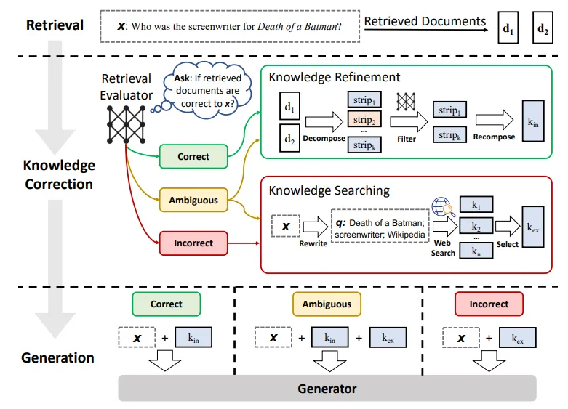
Drawback of RAG: Struggles to consistently filter out irrelevant or tangential information from retrieved documents.
Generates responses that, while grammatically correct, may fail to fully address user queries.
Provides unclear guidance, potentially leading to user frustration.
Reduces reliability, especially in customer-facing applications.
Transition to CRAG: To address RAG's limitations, we adopted CRAG, which enhances contextual awareness in both retrieval and generation. By leveraging advanced contextual embeddings and multi-stage filtering, CRAG ensures higher relevance and accuracy, delivering more precise and user-focused responses.

Slide 11
Corrective Retrieval-Augmented Generation
Phases of CRAG Operation:
Initial Corrective Retrieval: CRAG retrieves candidate documents from a knowledge base, enhanced by contextual embeddings (e.g., BERT, RoBERTa) for better alignment with the user’s intent.
Corrective Filtering: A multi-stage filtering process evaluates the relevance and contextual fit of the documents. This step ensures only the most relevant information is passed on for response generation.
Corrective Generation: The filtered documents are processed by a generative model to create a coherent, contextually appropriate response, ensuring the reply is accurate and tailored to the user's needs.

Slide 12
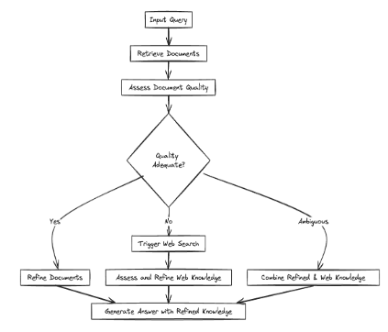
Advantages of CRAG:
Improved Query Resolution
Correct: Fetches direct answers from the database.
Ambiguous: Enhances responses with Bing Search for added context.
Wrong: Paraphrases answers using external search data for non-relevant queries.
Higher Accuracy: Reduces irrelevant data in responses, ensuring precision and user satisfaction.
Context-Driven: Effective in high-stakes applications like customer service, where reliable, context-aware responses are critical.
Advanced Techniques: Leverages contextual embeddings and multi-stage filtering to enhance response quality.

Slide 13
FAISS (Facebook AI Similarity Search)
Key Features of FAISS:
High-Performance Retrieval: FAISS processes large datasets in real-time, using vector embeddings to quickly identify the closest matches to user queries for fast, accurate retrieval.
Scalability: Efficiently handles growing knowledge bases, maintaining consistent performance as data demands increase, ensuring the chatbot remains responsive.
Customizability: Supports fine-tuning to adapt to specific datasets and use cases, such as university-specific information, offering flexibility to meet unique application needs.
Benefits of FAISS in the Chatbot:
Enables lightning-fast retrieval, reducing latency for smooth user interactions.
Integrates seamlessly with RAG and CRAG to deliver accurate, context-aware responses tailored to user queries.

Slide 14
03
Query Processing & Classification

Slide 15
Steps in Query Processing:
Preprocessing User Queries and Retrieved Articles | Text Conversion: Transformed to lowercase. Punctuation Removal: Strips unnecessary punctuation. Tokenization: Splits text into meaningful units. Stop Word Removal: Eliminates common, irrelevant words. Lemmatization: Reduces words to their base forms. Summarization (TF-IDF): Identifies the most relevant sentences.
Chunking Queries and Articles | User prompts are divided into smaller chunks using tools like AutoTokenizer. This helps comply with model constraints and ensures better alignment with stored knowledge chunks in the vector database.
Embedding Generation | The SentenceTransformer model (bert-base-nli-mean-tokens) generates embeddings for user queries, enabling semantic comparisons with stored knowledge chunks.

Slide 16

Classification Workflow:
Correct: If a query directly matches relevant documents, the system retrieves the information and generates a response.
Ambiguous: For partial matches, the system uses Bing Search API to gather additional context. The data is then preprocessed and added to the knowledge base.
Wrong: If a query lacks relevance, external content is retrieved via Bing Search, preprocessed, and used to generate a response.
Benefits:
Enhances contextual understanding.
Reduces inaccuracies.
Dynamically handles out-of-scope queries, ensuring comprehensive coverage.

Slide 17
04
Backend Architecture and Integration

Slide 18
The system integrates FAISS, Google Gemini 1.5 Flash, and the Bing Search API to deliver accurate, context-aware query resolution and response generation.
Core Components
FAISS Indexing:
Converts stored PDF and TXT data into vector embeddings for semantic search.
Processes thousands of documents in real-time using Euclidean distance for similarity.
Retrieves the most relevant knowledge chunks with high speed and accuracy.
Google Gemini 1.5 Flash:
Powers context-aware response generation through advanced prompt engineering.
Combines generative AI with reference data to produce precise, fluent, and tailored answers.
Ensures seamless and engaging conversational interactions.
Bing Search API:
Serves as a fallback for ambiguous or irrelevant queries.
Retrieves external information, refines it for relevance, and integrates it into the knowledge base.
Enhances future query resolution capabilities by expanding the system's knowledge scope.

Slide 19

Workflow:
Preprocessing & Classification: Queries are processed and classified.
Knowledge Retrieval: FAISS retrieves relevant chunks for correct queries.
Supplemental Data: Bing Search API adds data for ambiguous/unrelated queries.
Response Generation: Google Gemini AI generates accurate, context-aware responses.
Benefits:
Real-time query handling.
Reduced server load.
Enhanced accuracy and user satisfaction.

Slide 20
05
Data Flow and Model Optimization

Slide 21


Data Scraping and Organization:
Converting Data into Vector Embeddings:
Tools Used: BeautifulSoup and Selenium for efficient web scraping.
Sources: GSU-related web pages, including:
Departmental pages
Staff directories
Admissions data
Degree catalogs
Data Formats:
Limited to PDF and TXT for consistency and ease of processing.
Supports handling both structured and unstructured text efficiently.
Embedding Generation:
Used SentenceTransformer (bert-base-nli-mean-tokens) to convert documents into high-dimensional vector embeddings, capturing semantic meaning for precise query matching.
Storage and Search:
Embeddings were stored in FAISS indices, enabling fast and scalable similarity searches across large datasets.

Slide 22


Preprocessing Pipeline:
Scalability:
To optimize data for semantic retrieval, the following steps were implemented:
Text Cleaning and Normalization:
Lowercasing, removing punctuation, and eliminating stopwords.
Tokenization to structure text for efficient processing.
Lemmatization:
Reduced words to their base forms while preserving contextual meaning.
Summarization:
Used TF-IDF scoring to identify and retain the most relevant sentences.
Reduced noise, improving the knowledge base's quality and relevance.
Chunk-Based Processing:
Divided documents into smaller knowledge chunks for improved indexing and retrieval efficiency.
Knowledge Base Enrichment:
Continuously integrates refined results from ambiguous or irrelevant queries using the Bing Search API.
Preprocessing ensures only relevant data is added to the knowledge base.

Slide 23
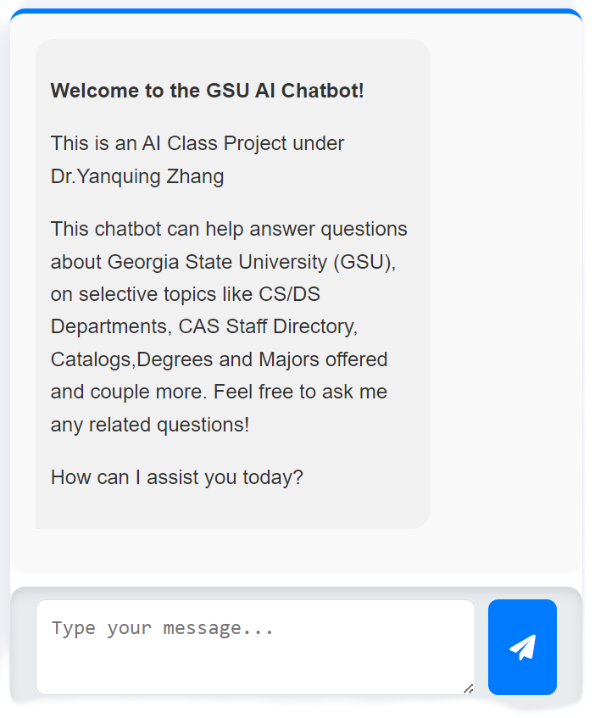
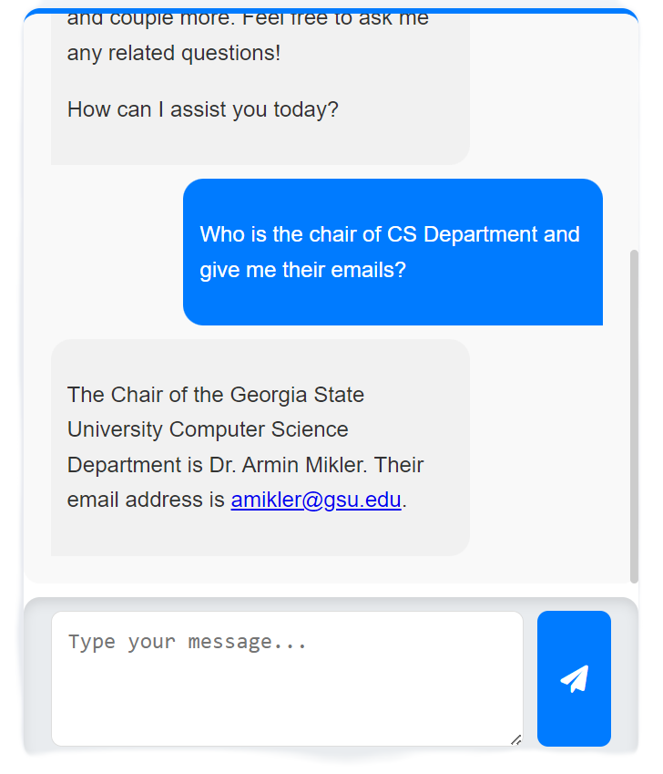
Current Working Prototypes

Slide 24
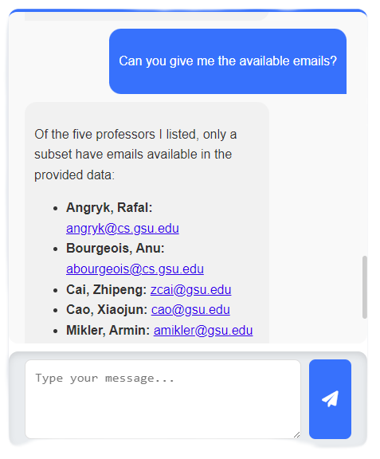
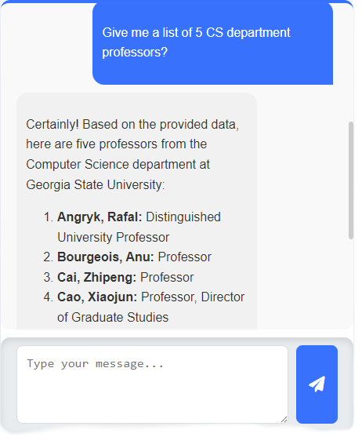
Current Working Prototypes

Slide 25
06
CONCLUSION

Slide 26


CONCLUSION
Solving Real-World Challenges
FUTURE WORKS
This chatbot simplifies access to vast and dispersed university-related information by delivering precise and contextually relevant answers in real time. It eliminates the need for users to navigate multiple websites, saving time and enhancing overall convenience. By processing queries locally, it also reduces server load, optimizes network performance, and ensures consistent responsiveness, even during peak usage periods.
Expand the data scraping capabilities to wider number of GSU web pages.
Migrate the database to cloud vector databases for faster search queries and optimizations.
Optimize the prompt better to better model understanding.
Experimentation on other types of RAG methodologies.

Slide 27
References
Monitor API Metrics https://developer.atlassian.com/platform/forge/monitor-api-metrics/
API Metrics – What and Why of API Monitoring https://www.catchpoint.com/api-monitoring-tools/api-metrics
Measuring User Interactions with Websites https://journals.plos.org/plosone/article?id=10.1371/journal.pone.0268212
What Is Retrieval-Augmented Generation aka RAG NVIDIA Blogs https://blogs.nvidia.com/blog/what-is-retrieval-augmented-generation/
Retrieval-Augmented Generation for Knowledge-Intensive NLP Tasks https://proceedings.neurips.cc/paper/2020/hash/6b493230205f780e1bc26945df7481e5-Abstract.html
Self-RAG: Learning to Retrieve, Generate, and Critique through Self-Reflection https://arxiv.org/abs/2310.11511
Self-Improving Retrieval-Augmented Generation for Adapting LLM to Specialized Domains https://arxiv.org/html/2410.17952v1
LLM System Prompt vs. User Prompt https://www.nebuly.com/blog/llm-system-prompt-vs-user-prompt
Advanced RAG Techniques Pinecone https://www.pinecone.io/learn/advanced-rag-techniques/

Slide 28

THANK YOU!

